Slide 1
Navigating the (Noisy) LLMs Landscape: How they Work and How to Make them Work!
Filotas Theodosiou: VIVES University of Applied Sciences, Kortrijk, Belgium
Notes:
Hi everyone, I am Filotas Theodosiou, I am a Data Scientist and Researcher at VIVES University of Applied Sciences and this is our joint work with Yves Sagaert and Liselot De Vlieger.

Slide 2
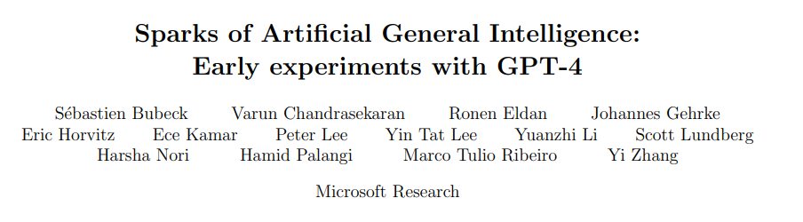

The Noisy Landscape
2024: The debate “Stochastic Parrot” vs “AGI”
Notes:
Time depends on total paths sampled
Increasing the number of paths lower CRPS. There is a point of diminishing returns
Binned validation errors outperform empirical methods without computational overhead
KDE adds extra computation cost but gives better performance

Slide 3
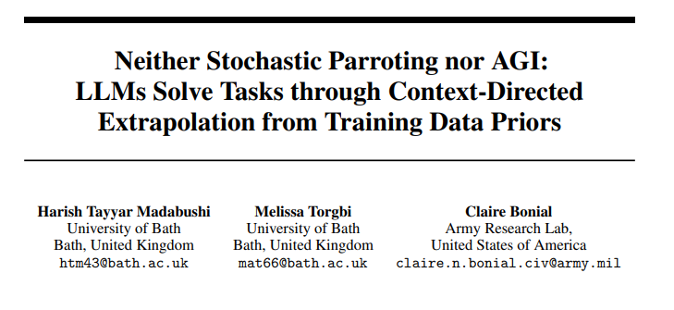
The Noisy Landscape
They work fine, lets not overhype things.
Notes:
Time depends on total paths sampled
Increasing the number of paths lower CRPS. There is a point of diminishing returns
Binned validation errors outperform empirical methods without computational overhead
KDE adds extra computation cost but gives better performance

Slide 4
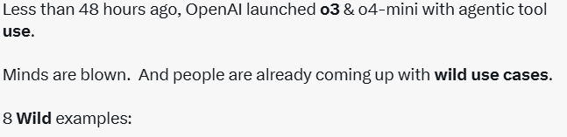
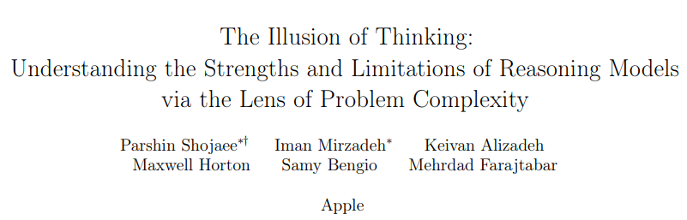
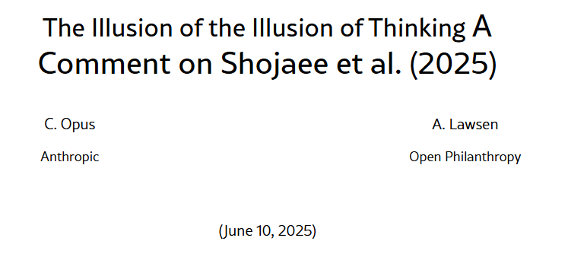
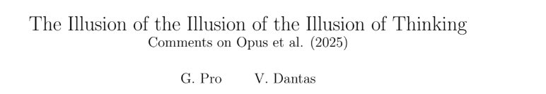
The Noisy Landscape
2025: The “Everyone talks about AI” year.
AI Influencers!
AI Labs
06/01/25: “We are confident how to build AGI”
20/01/25: “We are not building AGI next month, cut your expectations”
“Best model” every month

Slide 5
Content:
Lets denoise the field!
What is an LLM?
How an LLM works?
Some tips on how to make it work for you.
Notes:
Time depends on total paths sampled
Increasing the number of paths lower CRPS. There is a point of diminishing returns
Binned validation errors outperform empirical methods without computational overhead
KDE adds extra computation cost but gives better performance

Slide 6
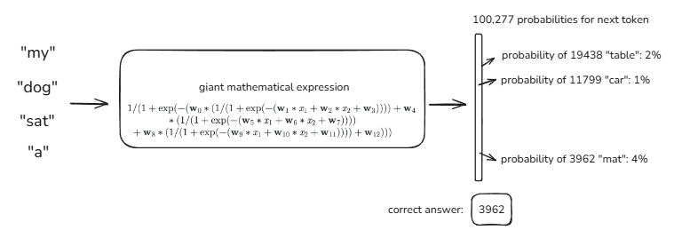
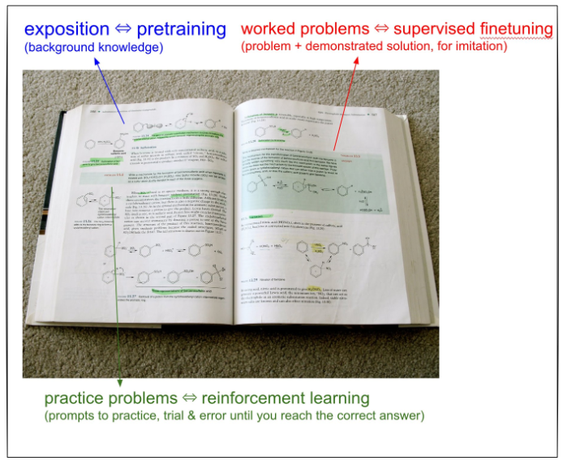
A Very Big Autoregressive Neural Network
It’s a Neural Network
Its trained autoregressively on text
Training is a multi-step process
https://www.youtube.com/@AndrejKarpathy
Notes:
Time depends on total paths sampled
Increasing the number of paths lower CRPS. There is a point of diminishing returns
Binned validation errors outperform empirical methods without computational overhead
KDE adds extra computation cost but gives better performance

Slide 7
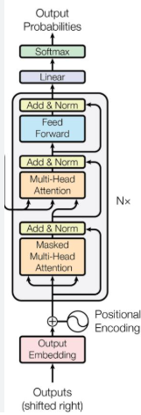
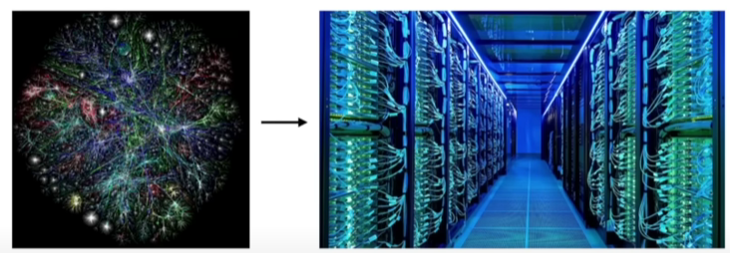
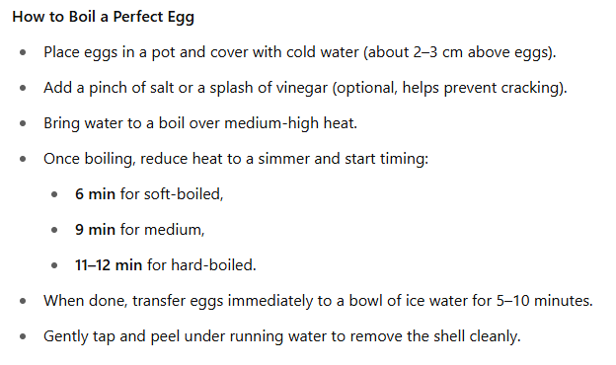

Pretraining: “A Lossy ZIP File of the Internet”
Whole internet (+ more)
GPT-4: 25.000 GPUs, 90-100 days, ~50-100 mil
Pretraining is a lossy compression of knowledge inside the model parameters
Build a “world-model” through internet knowledge
Do they understand? Imagine the following:
Last line of the book
The spy was …
Did you understand the content?
https://longportapp.com/en/news/92280171
https://lifearchitect.ai/gpt-4/?utm_source=chatgpt.com
Notes:
Time depends on total paths sampled
Increasing the number of paths lower CRPS. There is a point of diminishing returns
Binned validation errors outperform empirical methods without computational overhead
KDE adds extra computation cost but gives better performance

Slide 8
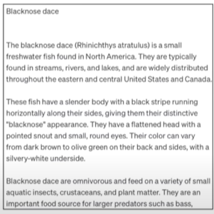

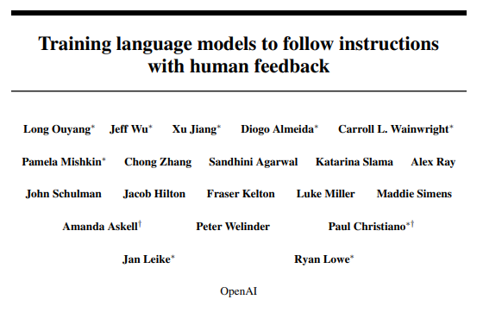
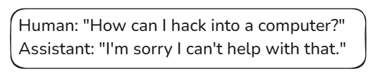
Post training: Turn Document Generators to Assistants
After pre-training
Post-training
(finetuning)
RLHF
The ChatGPT moment
Manual
Labelling is expensive
Limited
Not helpful
Hard to scale
Internal document generator
Wikipedia-like output
Manually assemble question-answer documents
Swap the training set & continue training
Keep the same training process
Notes:
Time depends on total paths sampled
Increasing the number of paths lower CRPS. There is a point of diminishing returns
Binned validation errors outperform empirical methods without computational overhead
KDE adds extra computation cost but gives better performance

Slide 9
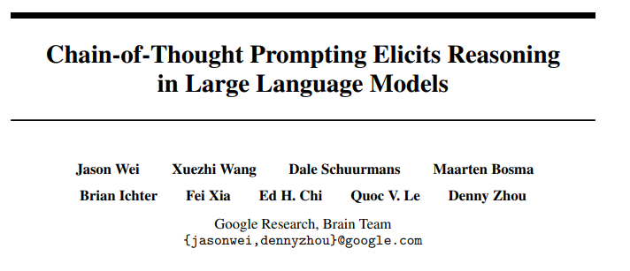
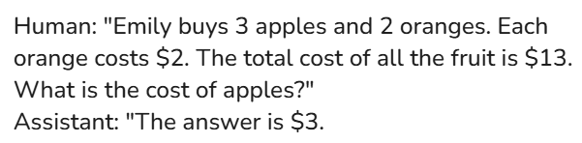
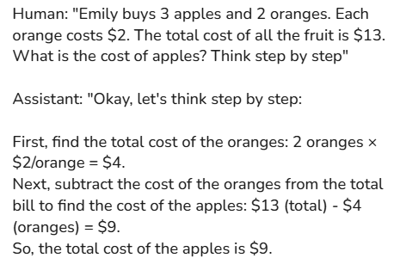
Are we back? Can we think?
Status after post training
But how many steps?
And what steps?
How can we generalize?
Notes:
Time depends on total paths sampled
Increasing the number of paths lower CRPS. There is a point of diminishing returns
Binned validation errors outperform empirical methods without computational overhead
KDE adds extra computation cost but gives better performance

Slide 10
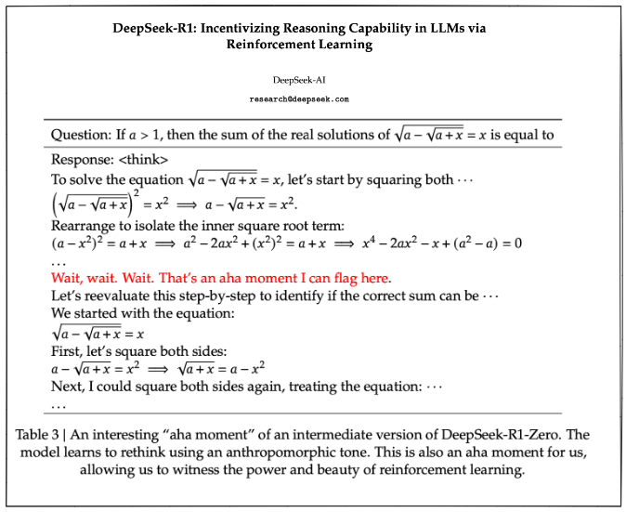
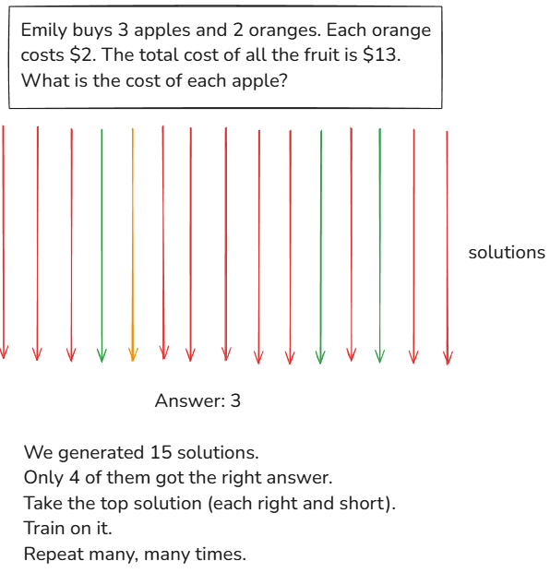
Are we back? Can we think?
Step by step thinking works for complex tasks
Part of “system instructions” on most models
Hard to scale!
Notes:
Time depends on total paths sampled
Increasing the number of paths lower CRPS. There is a point of diminishing returns
Binned validation errors outperform empirical methods without computational overhead
KDE adds extra computation cost but gives better performance

Slide 11
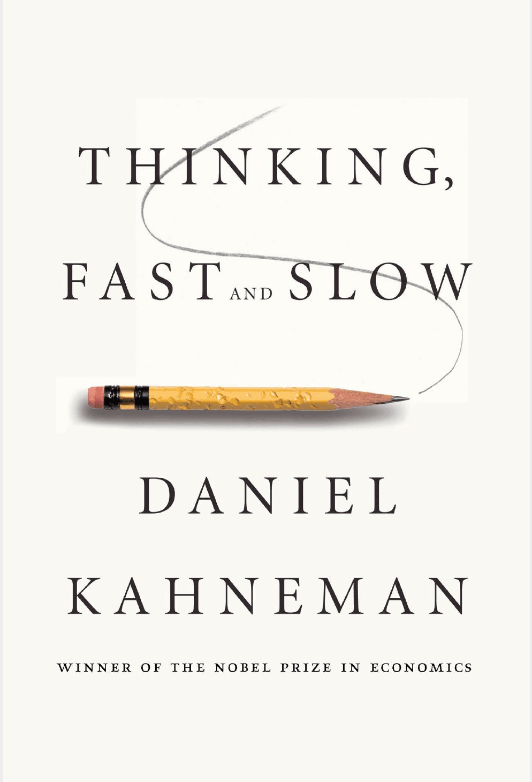
Navigating The Landscape:
Yeah AI is useful and productive! - As a tool to support your work -
There is a zoo of models (and another of products)
Reasoning vs non-reasoning
System 1 vs System 2 => When do you think and when do you act?
Use Thinking for “harder” problems (intuitively)
Please no more hype!
Sorry but influencers are not engineers nor scientists.
Different models are for different tasks and require different prompting
Hard to find what works well for you.
Find something that does the work and stick to it for some time.
Notes:
You got cheap models, you got expensive models, you got thinking models you have open models, you have closed models, you have everything you want

Slide 12
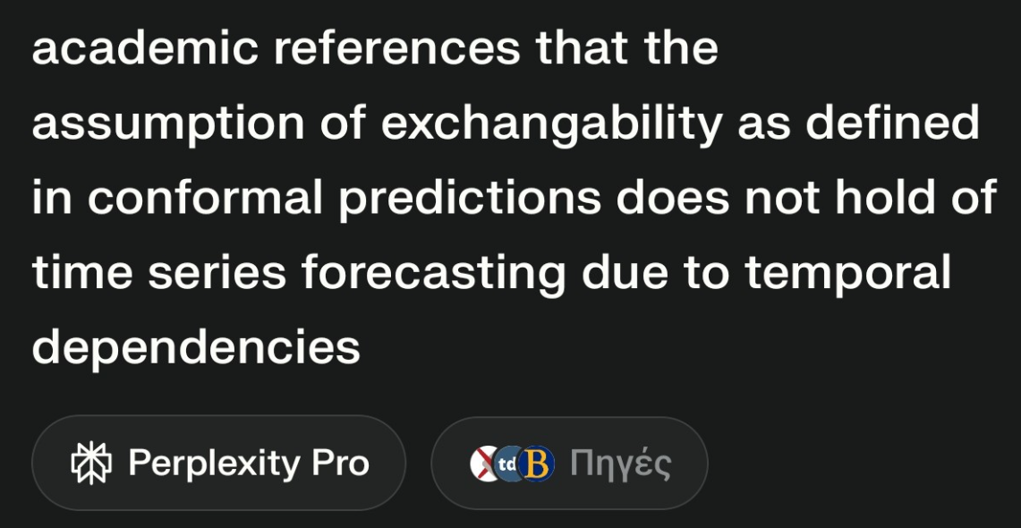
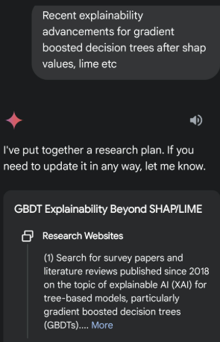
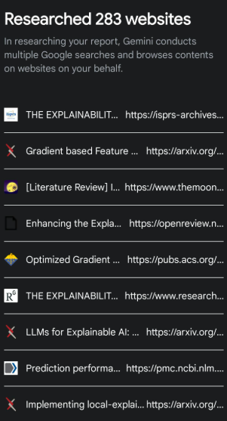
Some Product Ideas
Perplexity:
An AI – based Search Engine
For multi-folded Google Searches
DeepResearch:
Deep quick scan for a very technical topic
Slow, more all around (not actual research)
Reasoning models
Discuss your ideas in depth
Make it find weak points
Bonus: best bug founder
Non Reasoning Models:
Quick questions
Upload and discuss a paper
Notes:
Remember when we opened 10 tabs, summarized them and then did a new one.

Slide 13
Some Product Ideas
Perplexity:
An AI – based Search Engine
For multi-folded Google Searches
DeepResearch:
Deep quick scan for a very technical topic
Slow, more all around (not actual research)
Reasoning models
Discuss your ideas in depth
Make it find weak points
Bonus: best bug founder
Note: No, AI does the research for you!
It assists you ☺
Non Reasoning Models:
Quick questions
Upload and discuss a paper
Notes:
Remember when we opened 10 tabs, summarized them and then did a new one.

Slide 14
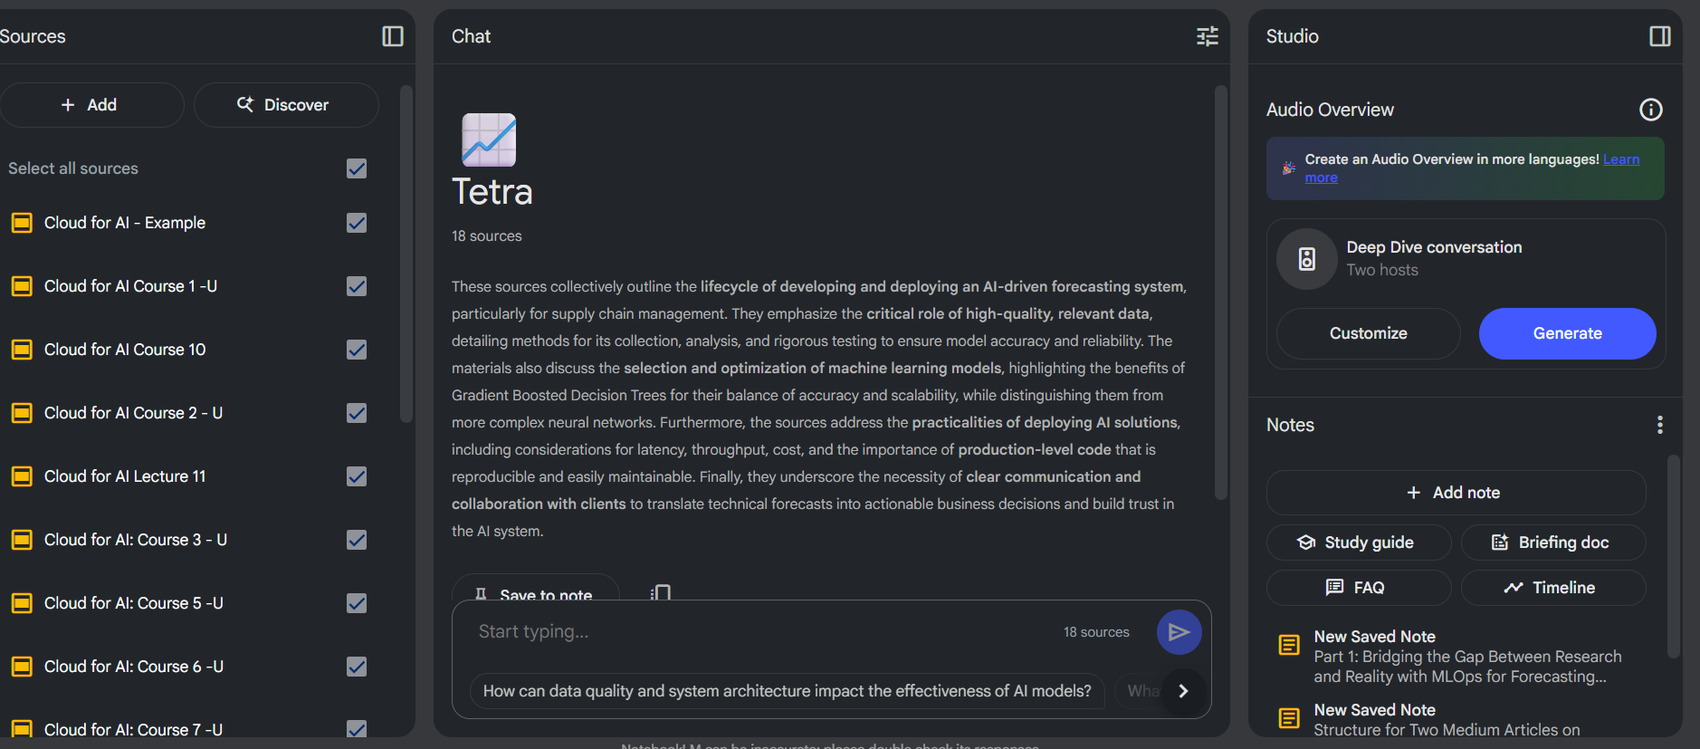
Organizing your ideas
NotebookLLM: Keep your projects files organized
Organize
Find needles, Get summaries
Discuss
Notes:
Time depends on total paths sampled
Increasing the number of paths lower CRPS. There is a point of diminishing returns
Binned validation errors outperform empirical methods without computational overhead
KDE adds extra computation cost but gives better performance

Slide 15
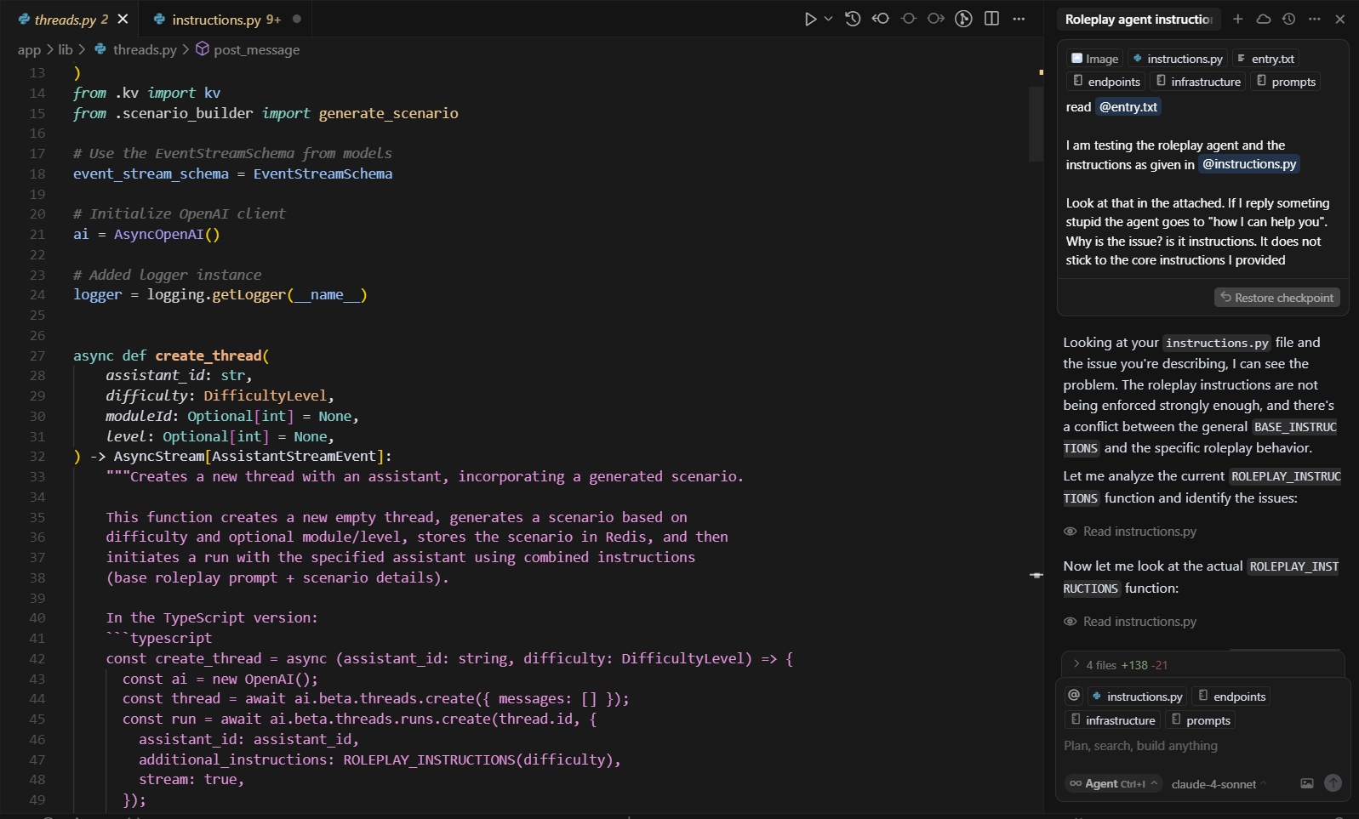
Implementing your ideas
Copilot is old already!
Full agentic apps not ready (yet)
Do not assume it will code everything
Be prepared to debug if you let it run on its own
Notes:
Time depends on total paths sampled
Increasing the number of paths lower CRPS. There is a point of diminishing returns
Binned validation errors outperform empirical methods without computational overhead
KDE adds extra computation cost but gives better performance

Slide 16


Writing your ideas
Some general ideas:
Find the model that matches your style.
Use it as an assistant, a tool.
You do the main work!!
People can figure when something is written by an LLM
You write
Propose
Corrects
Notes:
Time depends on total paths sampled
Increasing the number of paths lower CRPS. There is a point of diminishing returns
Binned validation errors outperform empirical methods without computational overhead
KDE adds extra computation cost but gives better performance

Slide 17
Ok, lets conclude!
LLMs are a great Tool! They will stay (and they will get better)
(As with any major technology) there are advantages disadvantages and hype
Your critical view is the most crucial asset
Its not a collaborator, it’s a tool. You are on the driving seat.
They (still) hallucinate. Do not blindly trust their output

Slide 18






Thank you for your attention
Questions ?
filotas.theodosiou@vives.be
https://github.com/FilTheo
https://www.linkedin.com/in/filotas-theodosiou/
©mrsiraphol

